Slide 1

Transfer Learning Using AlexNet

Slide 2
The steps are as follows:
1. Load in the dataset.
2. Import a pretrained network
3. Set up the network.
4. Train the network.
5. Evaluate the network’s accuracy.

Slide 3
Load Data Keyword: Transfer Learning Using AlexNet
Unzip and load the new images as an image datastore.
imageDatastore automatically labels the images based on folder names and stores the data as an ImageDatastore object.
An image datastore enables you to store large image data, including data that does not fit in memory, and efficiently read batches of images during training of a convolutional neural network.
unzip('MerchData.zip');
imds = imageDatastore('MerchData', ...
'IncludeSubfolders',true, ...
'LabelSource','foldernames');
This very small data set : contains 55 training，20 validation images.

Slide 4
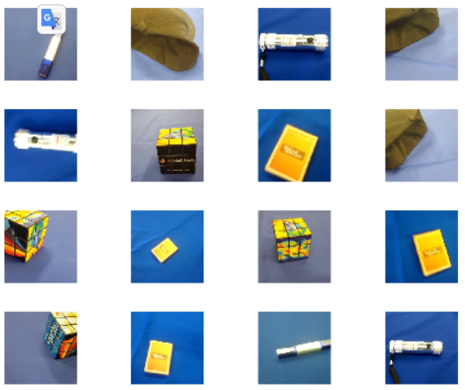
Data preparation
splitEachLabel splits the images datastore into two new datastores.
[imdsTrain,imdsValidation]
= splitEachLabel(imds,0.7,'randomized');
numTrainImages = numel(imdsTrain.Labels);
idx = randperm(numTrainImages,16);
Figure;
for i = 1:16
subplot(4,4,i)
I = readimage(imdsTrain,idx(i));
imshow(I)
end

Slide 5
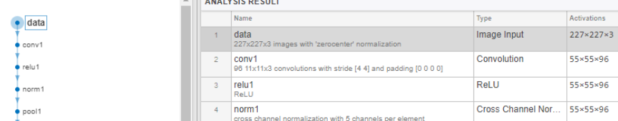
Load Pretrained Network
Load pretrained network and Use analyzeNetwork to
display an interactive visualization of the network architecture
net = alexnet;
analyzeNetwork(net)
inputSize = net.Layers(1).InputSize
inputSize = 1×3
227 227 3

Slide 6
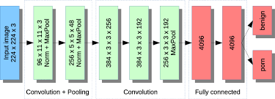

Slide 7
Replace final layers
Replace Final Layers
Extract all layers, except the last three, from the pretrained network.
layersTransfer = net.Layers(1:end-3);
Transfer the layers to the new classification task by replacing the last three layers
with a fully connected layer, a softmax layer, and a classification output layer.
numClasses = numel(categories(imdsTrain.Labels)); numClasses = 5
layers = [
layersTransfer
fullyConnectedLayer
(numClasses,'WeightLearnRateFactor',20,'BiasLearnRateFactor',20)
softmaxLayer
classificationLayer];

Slide 8
Image data augmentation :The network requires input images of size 227-by-227-by-3,
but the images in the image datastores have different sizes. Use an augmented image
datastore to automatically resize the training images.
pixelRange = [-30 30];
imageAugmenter = imageDataAugmenter
( ... 'RandXReflection',true, ... 'RandXTranslation',pixelRange, ... 'RandYTranslation',
pixelRange);
augimdsTrain = augmentedImageDatastore(inputSize(1:2)
,imdsTrain, ... 'DataAugmentation',imageAugmenter);
(2) Validationdata without augmentation
augimdsValidation = augmentedImageDatastore(inputSize(1:2),imdsValidation);

Slide 9
(3) Training option & training
options = trainingOptions('sgdm', ...
'MiniBatchSize',10, ...
'MaxEpochs',6, ...
'InitialLearnRate',1e-4, ...
'Shuffle','every-epoch', ...
'ValidationData',augimdsValidation, ...
'ValidationFrequency',3, ...
'Verbose',false, ...
'Plots','training-progress');
netTransfer = trainNetwork(augimdsTrain,layers,options);

Slide 10
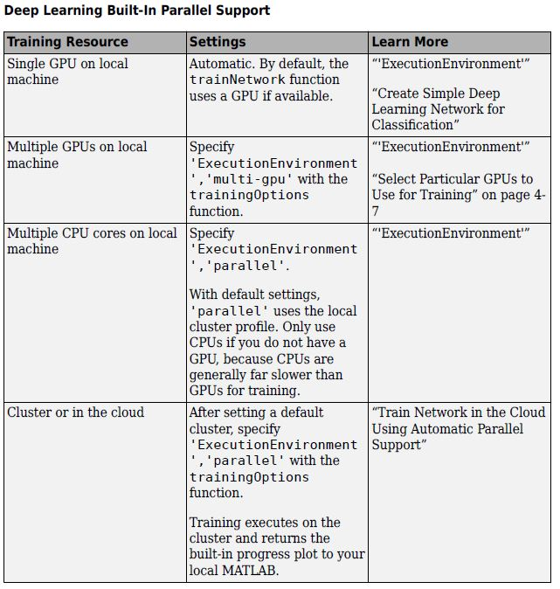
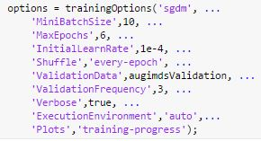
Gpu Environment setting
auto
multi-gpu
parallel

Slide 11
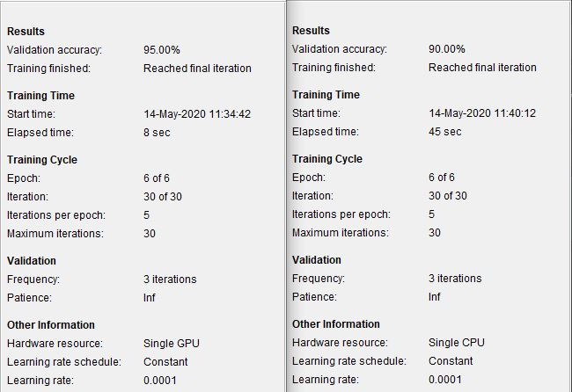

Slide 12
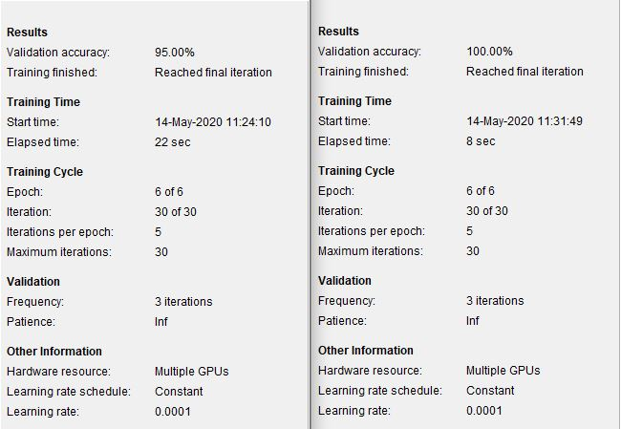
Could

Slide 13
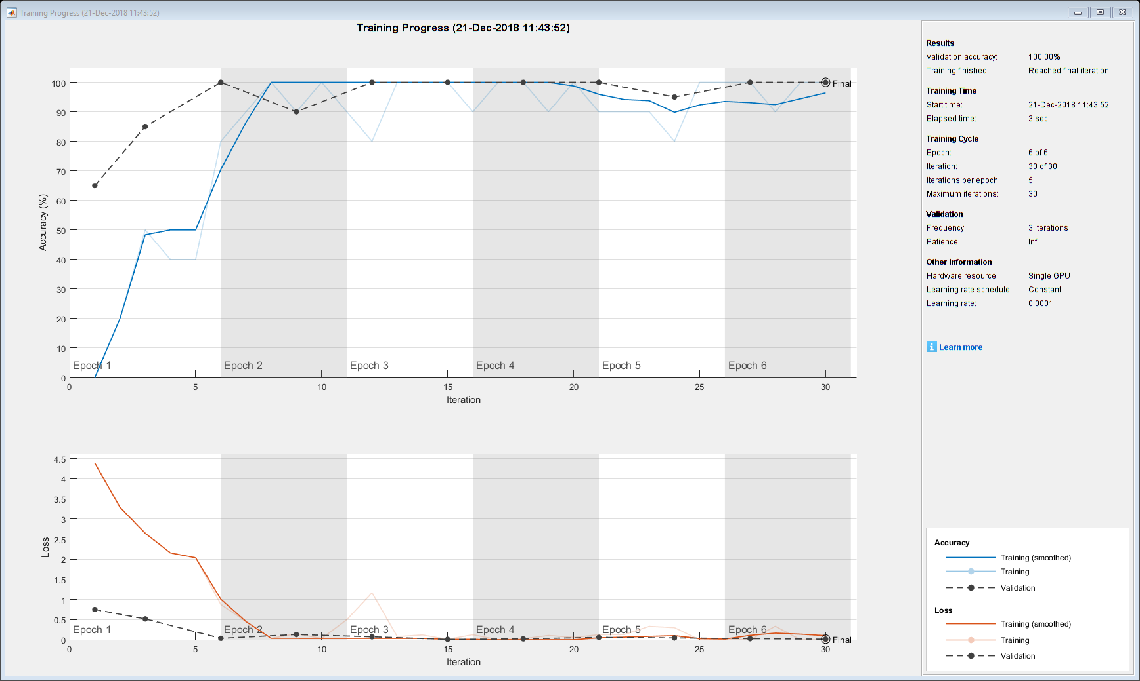

Slide 14
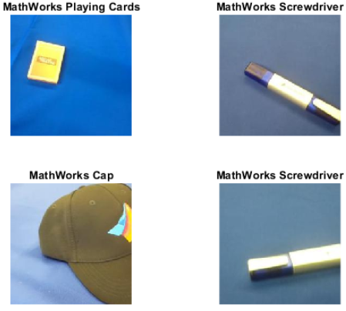
Classify Validation Images
Classify the validation images using the fine-tuned network.
[YPred,scores] = classify(netTransfer,augimdsValidation);
idx = randperm(numel(imdsValidation.Files),4);
figure
for i = 1:4
subplot(2,2,i) I = readimage(imdsValidation,idx(i));
imshow(I) label = YPred(idx(i));
title(string(label));
end

Slide 15
Document: Train Deep Learning Network to Classify New Images.pdf
Program: C:\Users\User\Documents\MATLAB\Examples\R2021a\nnet\TransferLearningUsingGoogLeNetExample

